Slide 1
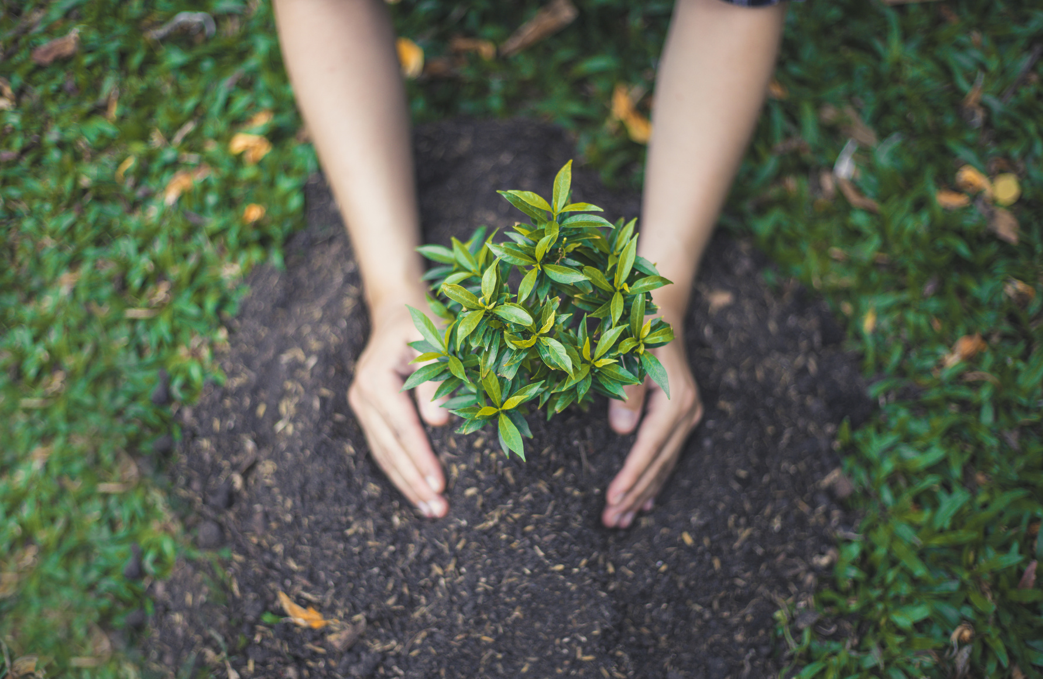
FEED
INDIA
FOUNDATION
Shreyas Bailkar
Shrushti Samant
Kunal Shenoy
Amogh Bedekar
Shravani Devke

Slide 2
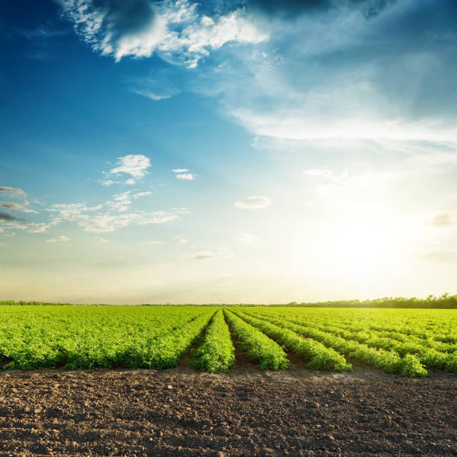
CONTENTS
PROBLEM STATEMENT
APPLIED TECHNOLOGIES
PROPOSED SOLUTIONS
PROJECT DETAILS
IMPACT OF SOLUTION
FUTURE SCOPE AND FEASIBILITY

Slide 3

PROBLEM STATEMENT
Rural India, where farmland is the main industry, struggles to combat hunger and malnutrition.
With changing weather, unpredictable crop yields, and a rising population, crop cultivation must be sustainable and efficient.
Farmers struggle to grow food due to a lack of modern technology, infrastructure, and soil quality, resulting in high rural malnutrition.

Slide 4
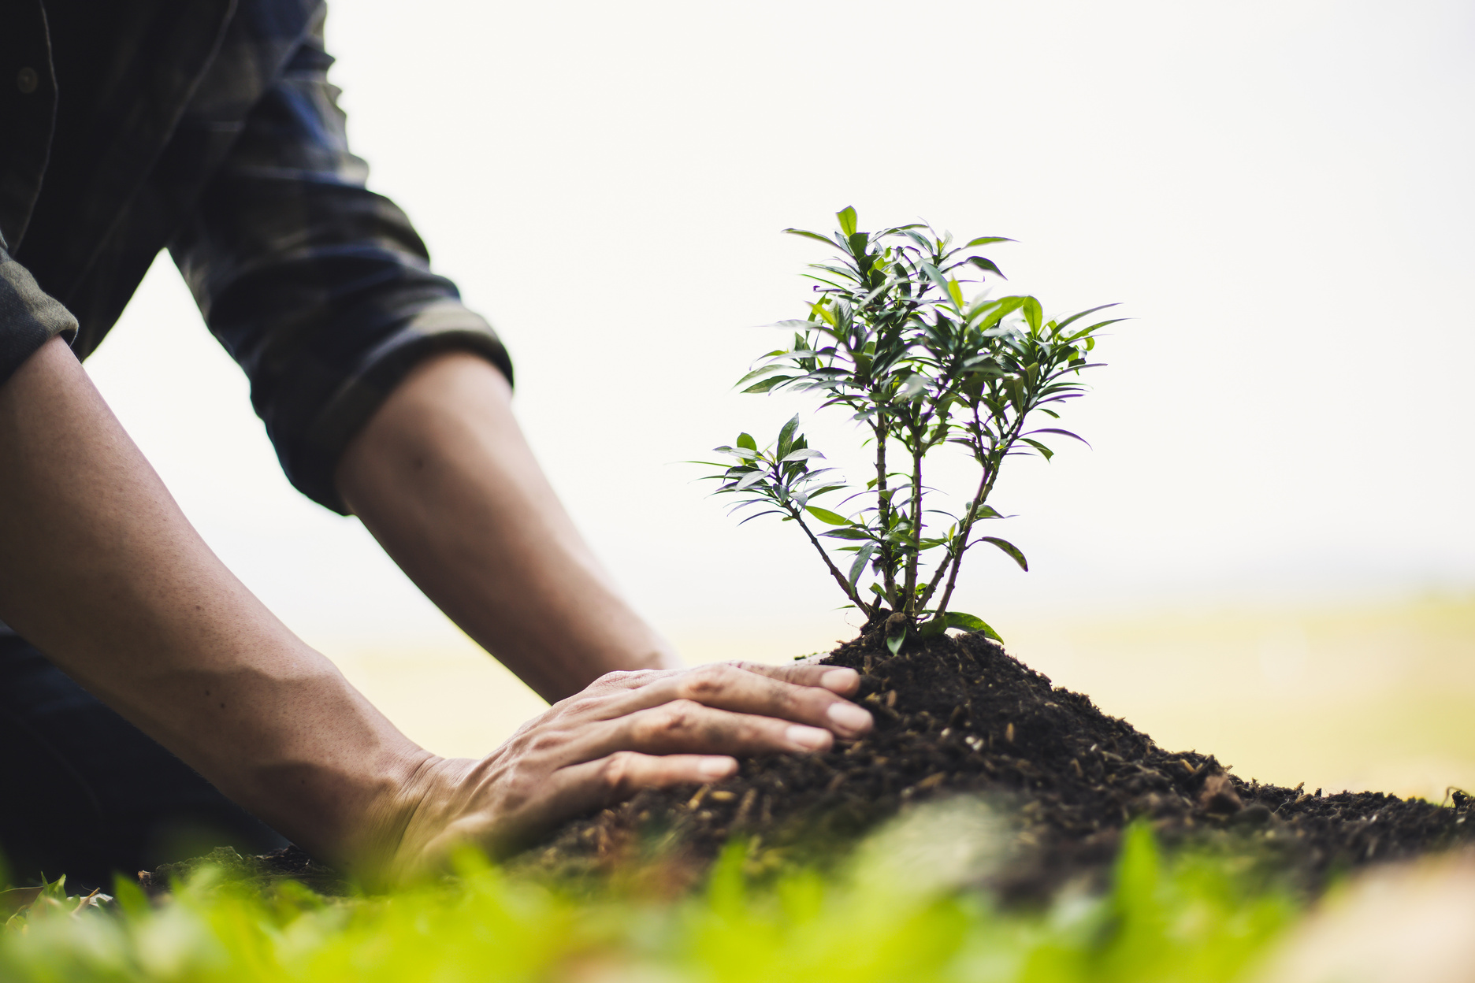
PROPOSED SOLUTIONS
We propose the development of an ML model that can predict the optimal crop cultivation for a particular region in India.
The model will consider weather, soil fertility, hunger index, malnutrition rate, nutrient requirements, topography, seed quality, and other aspects.
The model analyses and predicts these factors to suggest crops for a season and region to farmers.

Slide 5
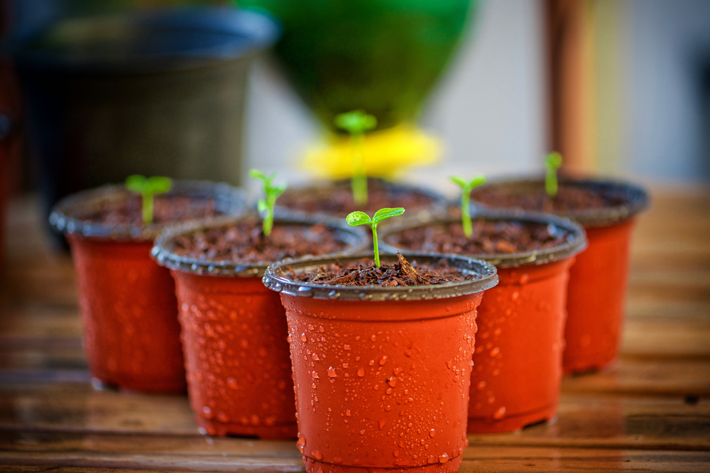
IMPACT OF SOLUTION
This ML-based solution will boost agricultural output and support sustainable crop cultivation, reducing hunger and malnutrition in rural India. Better crop yields, food availability, money, and livelihoods result from crop cultivation accuracy and efficiency.
The solution can also help farmers make informed choices, reduce their reliance on traditional methods, and promote modern agriculture technology.

Slide 6
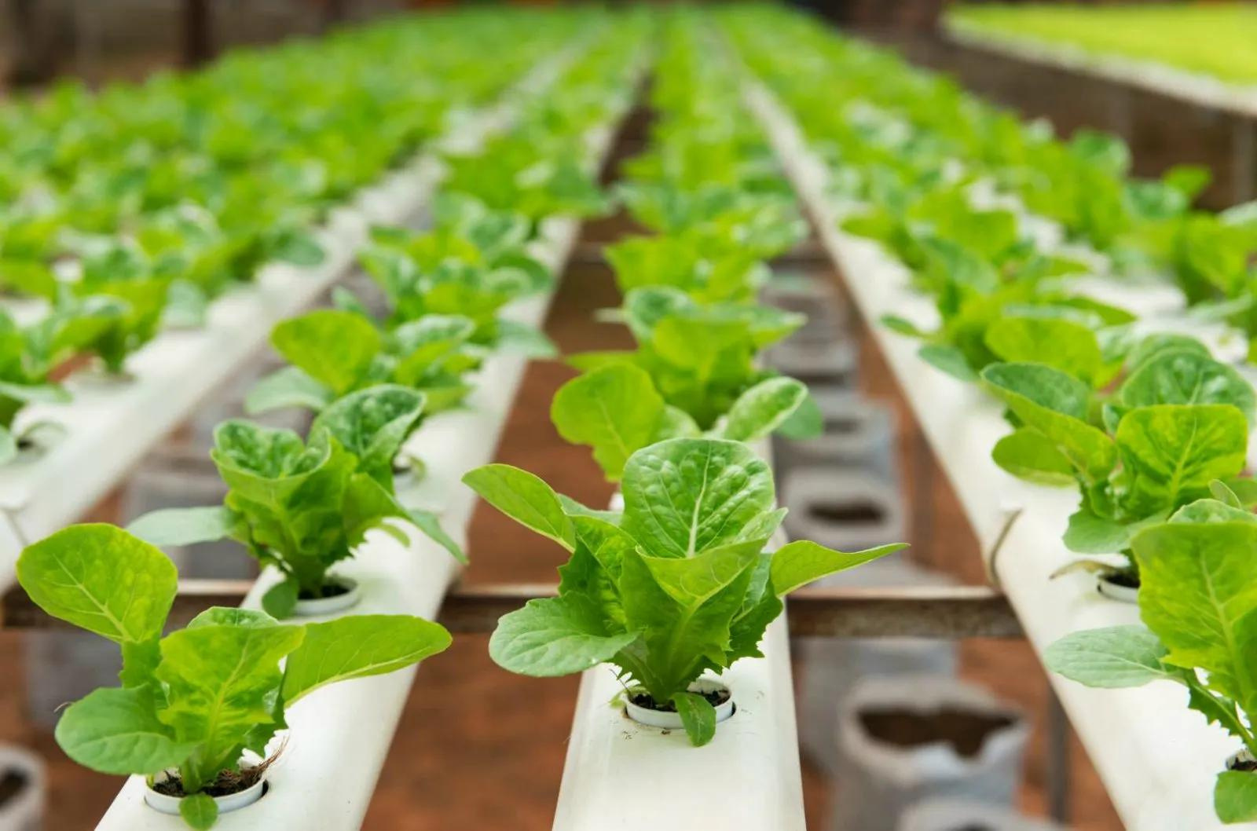
APPLIED TECHNOLOGIES
To develop this solution, we will use various technologies such as machine learning, data analytics, and artificial intelligence.
We will use Python programming language and popular libraries such as Scikit-learn, Pandas, and NumPy to develop the ML model.
We will also use data visualization tools such as Matplotlib and Seaborn to visualize and analyze the data.

Slide 7
PROJECT DETAILS
The project will involve the following steps:
1. Data collection: Collecting data on relevant factors such as weather conditions, soil fertility, hunger index, malnutrition rate, nutrient requirements, topography, and seed quality from various sources such as government reports, research papers, and other online databases.
2.Data preprocessing: Cleaning, transforming, and formatting the data to make it suitable for the ML model.
3.Model development: Developing an ML model using various algorithms such as decision trees, random forests, and support vector machines to predict the optimal crop cultivation for a particular region in India.

Slide 8
PROJECT DETAILS
The project will involve the following steps:
4.Model validation: Evaluating the accuracy and performance of the model using various metrics such as mean squared error, R-squared, and cross-validation techniques.
5.Deployment: Deploying the model in a user-friendly interface, allowing farmers to input their region, month, and other relevant data to receive recommendations on the most suitable crops to grow.

Slide 9
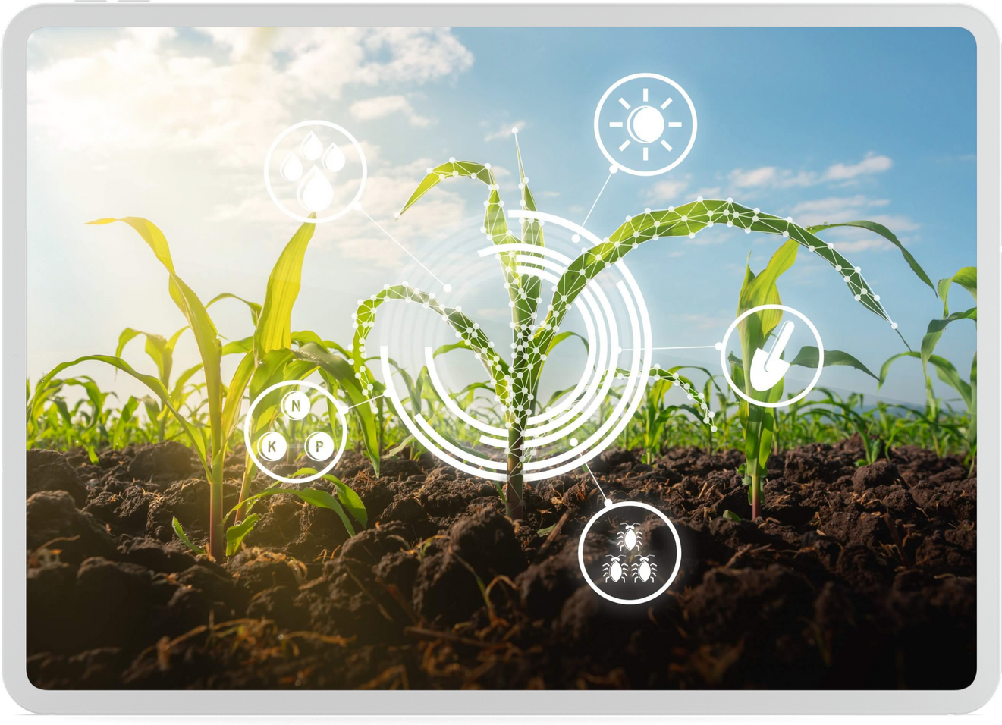
FUTURE SCOPE AND FEASIBILITY
The proposed solution has great scalability and feasibility potential.
Market prices, irrigation patterns, and agricultural government plans can be added to the model as data and ML and AI technologies improve.
To expand its scope and usability, the model can be used in mobile apps and web portals.
By encouraging sustainable and effective crop cultivation, the answer could reduce hunger and malnutrition in India.

Slide 10
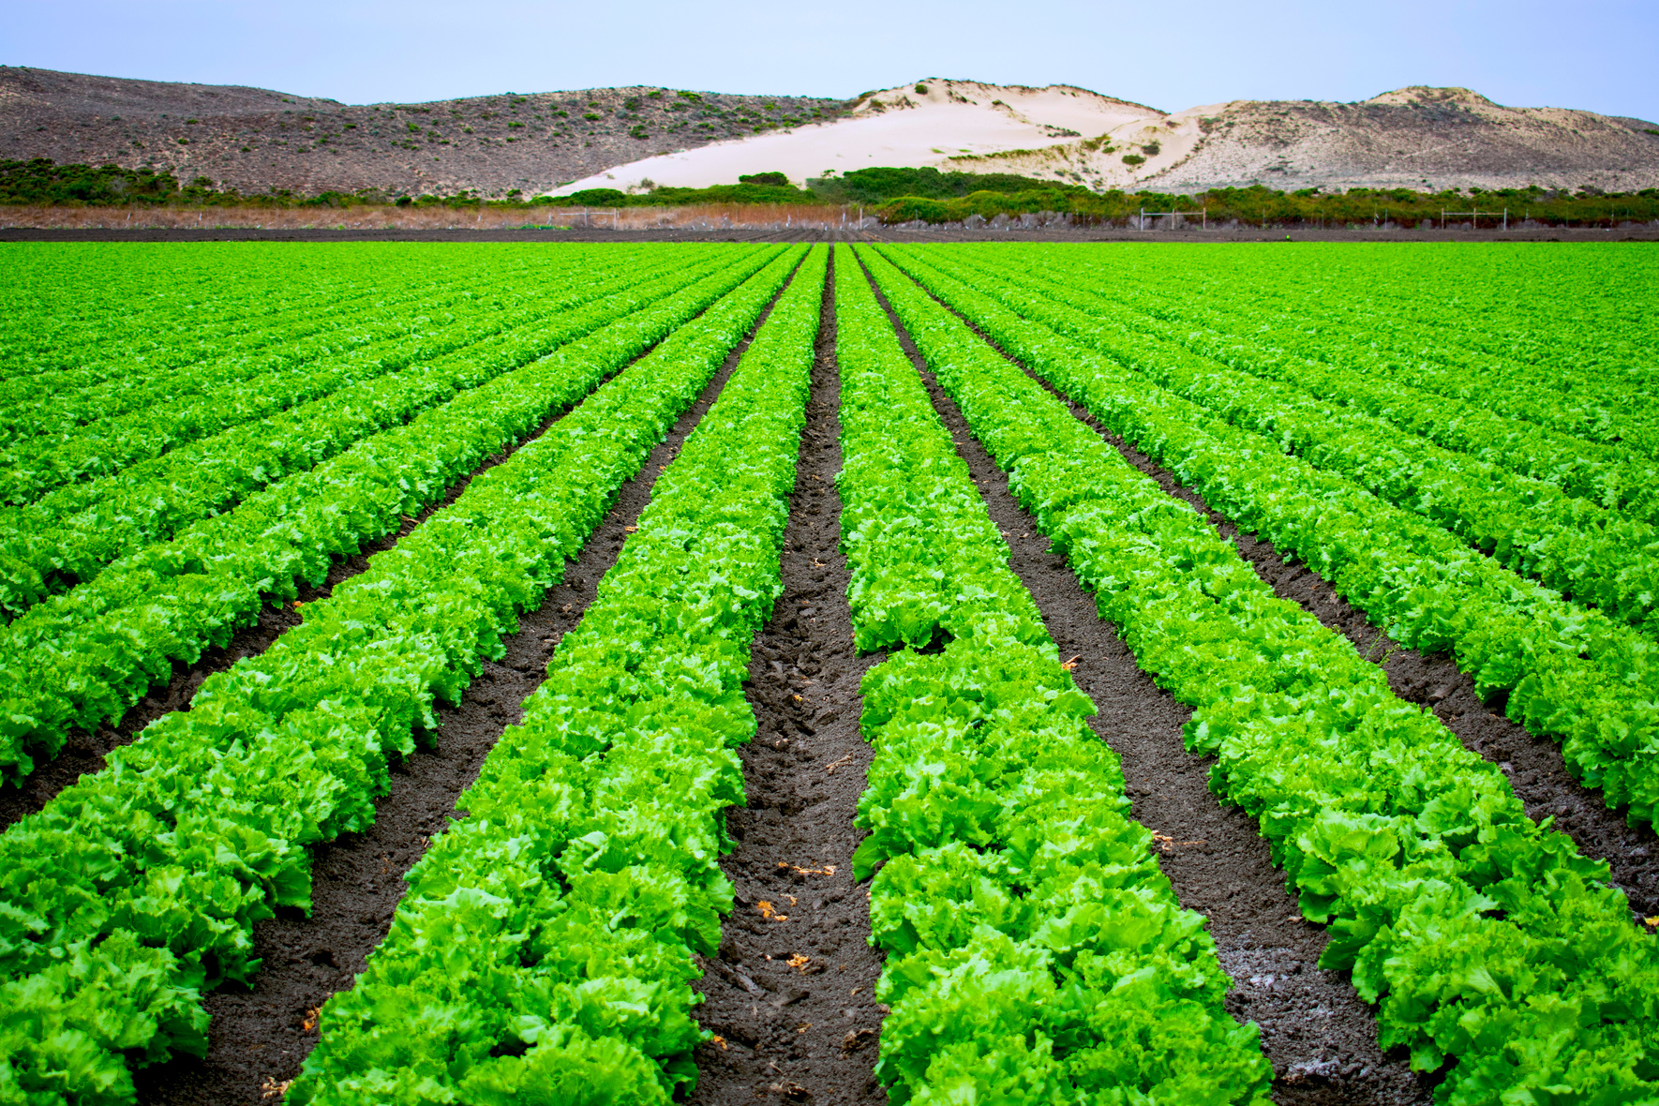
PROPOSED REMARKS WITH SOLUTIONS
Reduce Human Dependency :-
Installing sensors in farms which would collect data of temperatures, soil properties, weather conditions, humidity, etc.

Slide 11
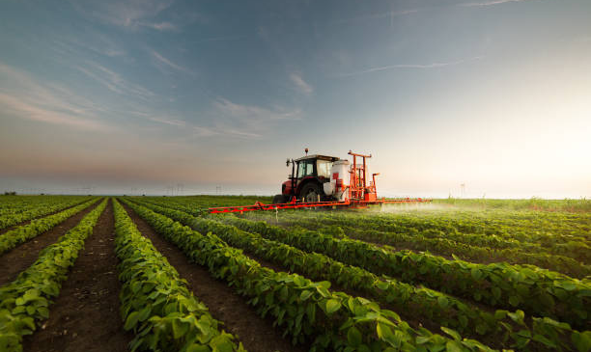
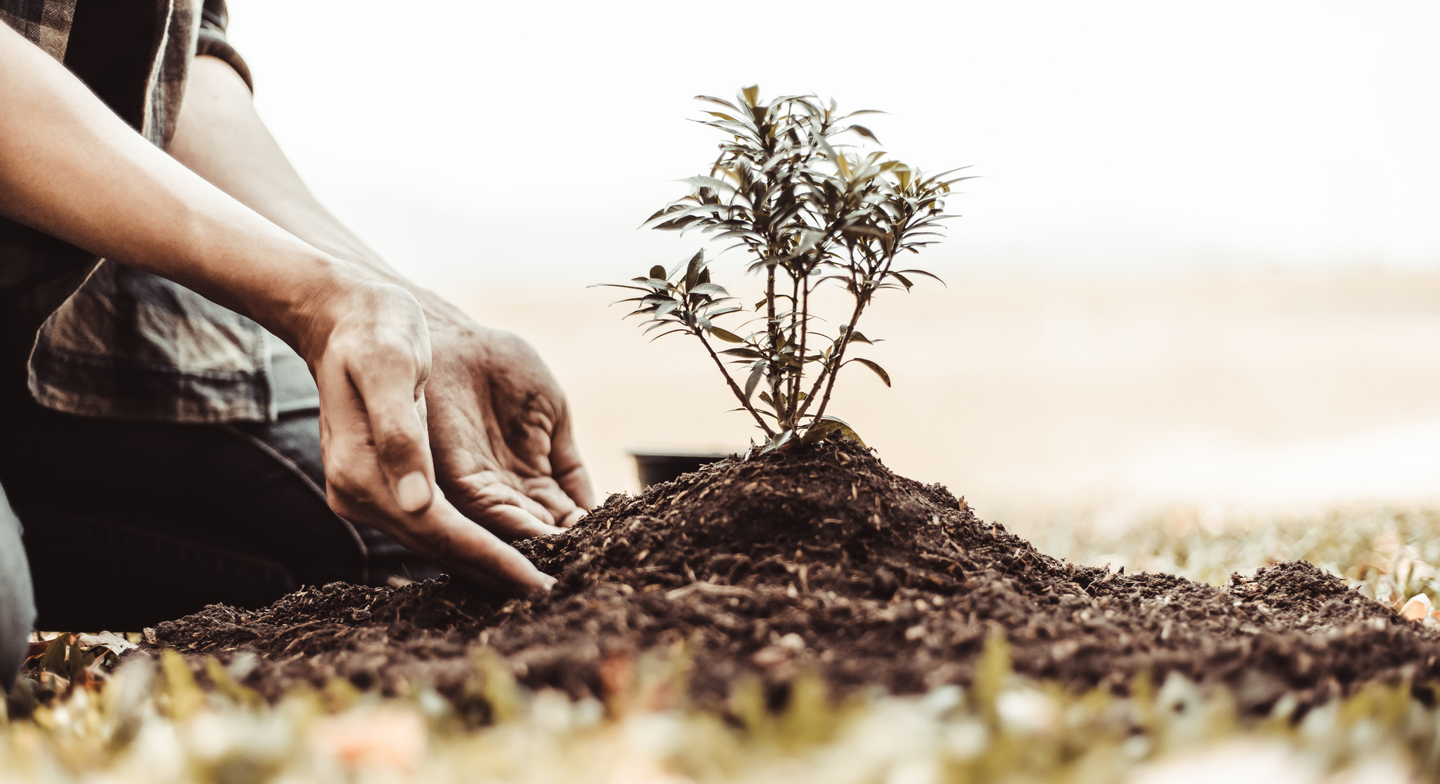
THANK YOU!
end of this presentation

